Slide 1

Chapel St Leonards Primary School SEND information report
2025/2026
This report should be read alongside our SEND policy (available at https://www.chapel-cit.co.uk/web/special_educational_needs/343986)

Slide 2
Contents:
Key contacts
SEND journey
Graduated approach
SEN needs
Parents/ carers involvement
Support for your child
Pupil involvement
Staff training
Supporting wellbeing
Identifying SEND in EYFS
Children’s involvement
Curriculum support
Child’s attainment and achievement
Transitions
Extra- curricular activities
Support for families
Complaints procedure
Any further information

Slide 3
Key Contacts:
If you have any concerns that your child might have a special educational need or is finding learning difficult, you should contact your child’s class teacher.
Our special educational needs coordinator (SENDCo) is Miss Charlotte Smith
The role of the SENDCo involves ensuring that:
Teachers understand a student’s needs
Teachers are trained in meeting those needs
The quality of teaching for students with SEND, and
Provision across the school is efficiently managed.
Our Headteacher is Mrs Sherilyn Borrell. She can be contacted through the office.
Our SEND governor is Mrs Nicola Green. She can be contacted through the office.
enquiries@chapel-cit.co.uk

Slide 4

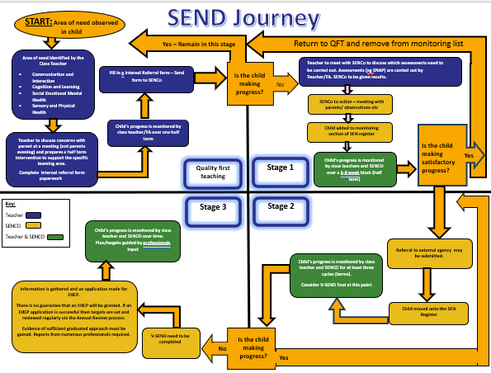
SEND journey
Identifying SEND and the graduated approach
The school takes a consistent and structured approach to recognising and meeting the needs of pupils with SEND. We understand that identifying needs early and putting the right support in place makes a significant difference to children’s long-term progress and outcomes.
Currently, pupils are identified through Pupil Progress Meetings as well as teacher concerns, which are submitted using a Cause for Concern form. This process follows the SEND Journey Flow Chart, helping us to ensure pupils with SEN are accurately identified and supported through the correct pathways.
Once a pupil has been recognised as needing support, the Assess, Plan, Do, Review cycle begins. The class teacher will record the child on the Individual Education plan and provide targeted support. This provision is monitored jointly by the Class Teacher and the SENCo, with next steps reviewed and agreed together.
Parents and carers are informed once a pupil is placed on the SEN Register.
The school keeps a SEND tracker, which is reviewed and updated regularly by the SENDCo to ensure records remain accurate and up to date.

Slide 5
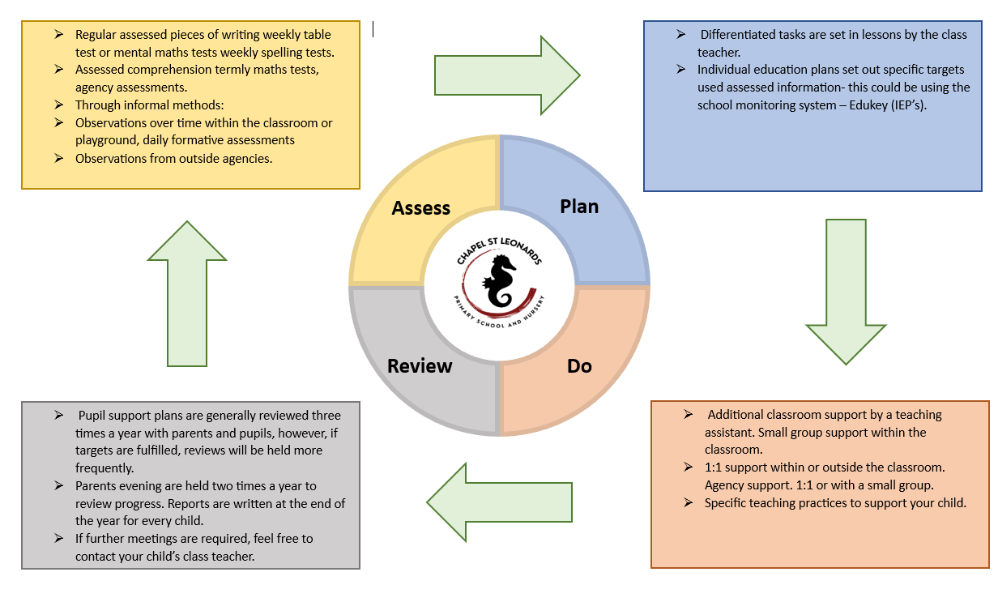
Graduated approach to supporting pupils with SEN:

Slide 6
What special educational needs do we cater for?
We cater for the four broad areas of SEN
These include:
Communication and interaction (CI) | Cognition and learning (CL) | Social, emotional and mental health needs (SEMH) | Sensory and/ or physical (SP)
Speech, language and communication needs Autism spectrum disorder/ condition | Moderate learning difficulties (MLD) Specific learning difficulties (SpLD) | Attention deficit disorder (ADD) Attention deficit hyperactivity disorder (ADHD) Attachment disorder | Hearing Impairment Multi- sensory impairment Visual impairment Physically disabled

Slide 7
How we involve parents/ carers:
We strongly believe it is vital that parents/ carers are involved with the support given and progress made by their child.
The SENDCo and class teachers will be available to speak to parents/ carers at parents evenings.
Meetings can be booked to meet with the SENDCo to share any concerns.
Parents/ carers are invited to attend EHCP annual reviews.
All parents have access to Edukey- an app that will show their child’s IEP’s and pupil passports.
Teachers are available for parents/ carers to speak to when they greet your child at the door.

Slide 8
Supporting your child in school:
Internal support:
Class teacher: will set tasks that are appropriate and accessible.
TA’s: support all pupils in the class. May provide 1:1 to a small group of children.
SENDCo: completes referrals to agencies. Monitors children’s progress and will hold review meetings.
Midday supervisors: provide support monitoring personal, social and emotional needs.
SEND governor: oversees the SEN policy. Yearly visits to the school with the SENDCo.
Volunteers: support children with reading.
External agencies:
Helen Pitfield : the working together team
Haley Marsh: Mental health support team
Sophie Enever: Mental Health support team
Educational psychologists
Paediatricians- referrals can be made by the school.
Child and Adult Mental health service
ASK SALL

Slide 9

Pupil involvement:
The teachers support me when I am stressed with learning by reading the work.
I feel happy when I can go to the sensory room because it helps me be calm.
I feel supported with my diabetes because the teachers are there to support but are helping me become independent with it.
I enjoy time to play basketball for 10 minutes for calm down and reward time.
Child
centred
I can go to a teacher when I need help and it makes me happy that I have a comfort toy.
I enjoy music time with an adult and a friend as a reward for good choices.

Slide 10
What training have our staff had in order to support your child with SEN?
Training and experience:
First aid – yearly first aid training provided to all members of staff.
Safeguarding – yearly training provided to all staff and courses throughout the year.
Team teach – a selection of staff in school are team teach trained in de- escalation techniques.
Autism and dyslexia (Miss Smith- SENDCo)
Staff members receive regular up- to- date training on SEN.
The SENDCo has the following qualifications:
BA (Hons) education studies with special educational needs and inclusion.
Completed a NASENDCo award with Northampton University.
Adaptive teaching (the process of including all children’s needs in learning) is an integral part of our school’s values.
Our teaching assistants will continue to access ongoing training and guidance to support children in school.

Slide 11
Supporting wellbeing:
Mrs Borrell is our designated safeguarding lead and Miss Summers and Miss Stones are our deputy designated safeguarding leads.
Mrs Borrell works in and out of the classroom to support children and families and give them a safe place to speak.
Miss Smith is our mental health lead for the children. She will have regular meetings with teachers on the wellbeing of children and will have termly meetings with the mental health support team to speak about individual children and gain advice.

Slide 12
Identifying SEND in EYFS:
We use observations and assessment tracking systems (refer back to our SEND journey).
A child’s needs will be specifically targeted according to development matters and early learning goals.
Targets will be reviewed at meetings with class teacher and SENDCo, at parent’s meeting and focus child meetings.
There are a range of programmes that we use to support your child’s learning:
Read write Inc- Phonics
Social communication programmes and games

Slide 13
Children’s involvement:
Review meetings:
Your child will be asked for their thoughts regarding: their progress towards their targets.
What strategies have worked well
What they think they need more support with.
Social stories:
These are written with individual children to help them understand how to manage their emotions or behaviour in certain situations.
Feelings book:
They would be used for children who find it difficult to express themselves orally.

Slide 14

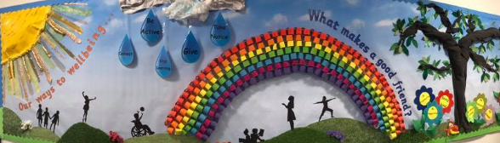
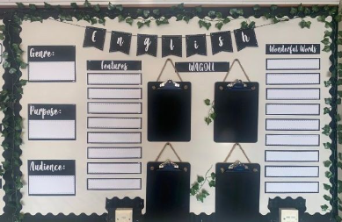

Curriculum support:
Visual timetables
Displays
Working walls
Word mats
Practical equipment
Magnetic letters
laptops to record
Careful positioning of
children.

Slide 15
Child’s attainment and achievement:
Opportunity: | Details: | Frequency:
Review meetings/ parent consultations | Individualised education plans are reviewed with staff. Educational health care plans are reviewed with parents and pupils. | 3 times a year Once a year
Assessment or observation feedback (outside agencies) | Feedback is given for an assessed report or observation from an outside agency or SENDCo. If reports coincide with review meetings they will be discussed then. | When appropriate.
Class teacher feedback | If there are concerns or a celebration of success, you may be phones or asked to a meeting. | When appropriate.
Home/ school communication | If there are behaviour, medical or anxiety issues, a communication book or diary may be sent home. | Daily or weekly where appropriate.

Slide 16
Transition:
EYFS:
The teacher and teaching assistants visit feeder nurseries when possible. Parents are encouraged to look round with their children.
Visits can be arranged the term before starting.
School receives and uses relevant paperwork to plan extra support if needed. Agencies involves are consulted.
Parents are given an opportunity to attend an information event before their child starts in September.
Year groups:
Exchange of information between classes, including successful strategies. Time with the new teacher before the end of the summer term.
Extra lessons with the new teacher can be arranged if a pupil is particularly anxious.
Secondary school:
Meetings are arranged with SENDCo’s from secondary schools for parents if required.
Information if shared with the secondary school through transfer paperwork, face to face meetings, emails etc.
Additional visits are put in place to meet each child’s individual needs.
If your child has an educational health care plan, relevant agencies and the secondary school SENDCo will be invited to the annual review prior to transition.

Slide 17
Extra- curricular activities:
Educational visits are an integral part of the curriculum at Chapel St Leonards Primary. All pupils are included with special needs being considered in risk assessments.
All pupils are entitled to take part in clubs after school and are encouraged to do so. Some clubs are so popular a reserve list system has had to be put in place.
We have a breakfast club, which all pupils may attend, starting at 7:45am.

Slide 18
Support for families:
Organisation: | Telephone: | Website/ email:
Lincolnshire county council |  | www.lincolnshire.gov.uk
Information, advice and support services network | 08001951635 | www.lincolnshire.gov.uk/liaise Email: liaise@lincolnshire.gov.uk
The national autistic society |  | www.autism.org.uk
Young Minds | Parent helpline: 08088025544 | www.youngmind.org.uk
KIDS | 01522542937 | www.kids.org.uk

Slide 19
Complaints procedure:
If you feel that something is not going quite are you would like it to, that we are doing something that you are unhappy with, or not doing something that you feel we should, please tell us about it.
First step: Please arrange to discuss any concerns with your child’s class teacher, or with the particular teacher concerned.
Second step: If, after speaking with your child’s teacher, you do not feel that your complaint has been properly dealt with, then you should discuss the matter with that teacher’s manager.
Third step: You should make a formal written complaint to the headteacher, unless the complaint is about the conduct of the headteacher. You should then receive a written response.
Taking matters further: if your complaint is about the conduct of the headteacher, or, if you are dissatisfied with the headteacher’s response to your formal complaint letter, then you will need to contact the governors.

Slide 20
Any further information:
If you require any further information or help, please contact:
Your child’s class teacher
The front office
The SENDCo (Miss Smith)
The Head Teacher (Mrs Borrell)

